Slide 1


Smart Doorbell-System Using Computer Vision and IoT
Project by:
Wisam Ramadan
Samer Hammoud
Supervisor: Dr. Abdel-mehsen Ahmad
Committee member: Dr. Samir omar
Spring 2020-21

Slide 2
Outline
Introduction
Problem statement
Related work
Proposed system
System design
System implementation
Results
Conclusion & future work

Slide 3
introduction

Slide 4
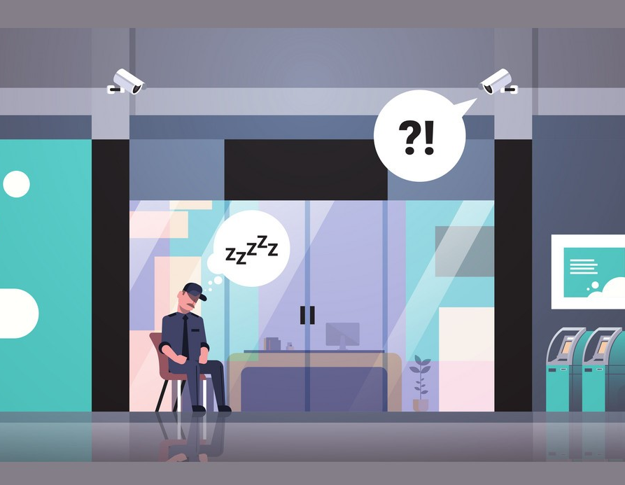
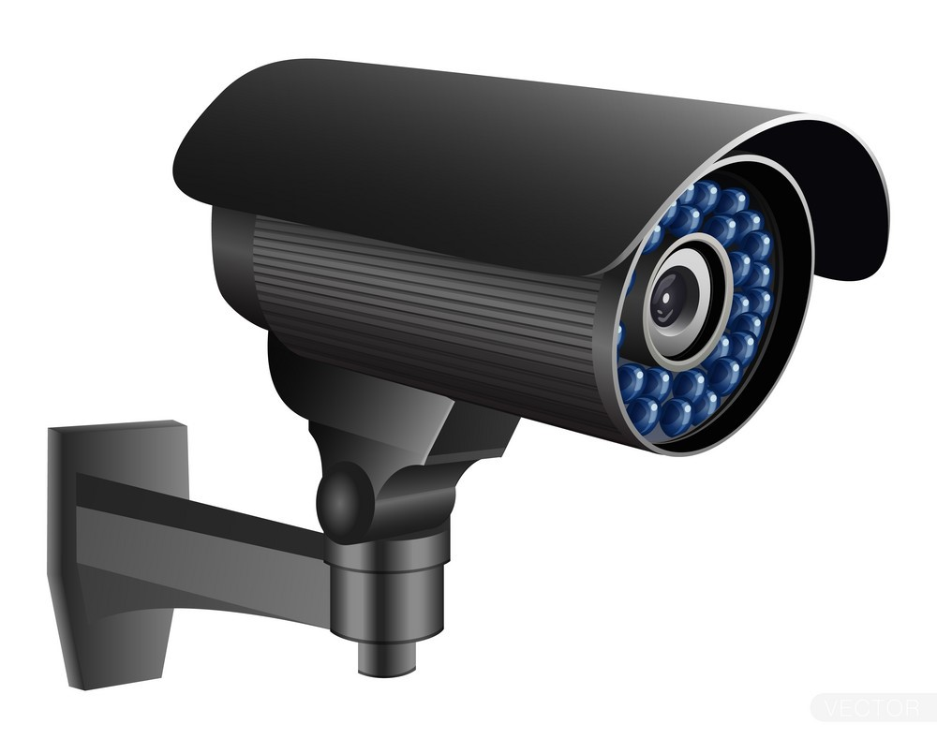
Introduction: Security position
Traditional security practices.
Expansion to involve hardware system (e.g., Surveillance Camera, Alarming system).
What is IoT?
What is a Doorbell System? How is it different?

Slide 5
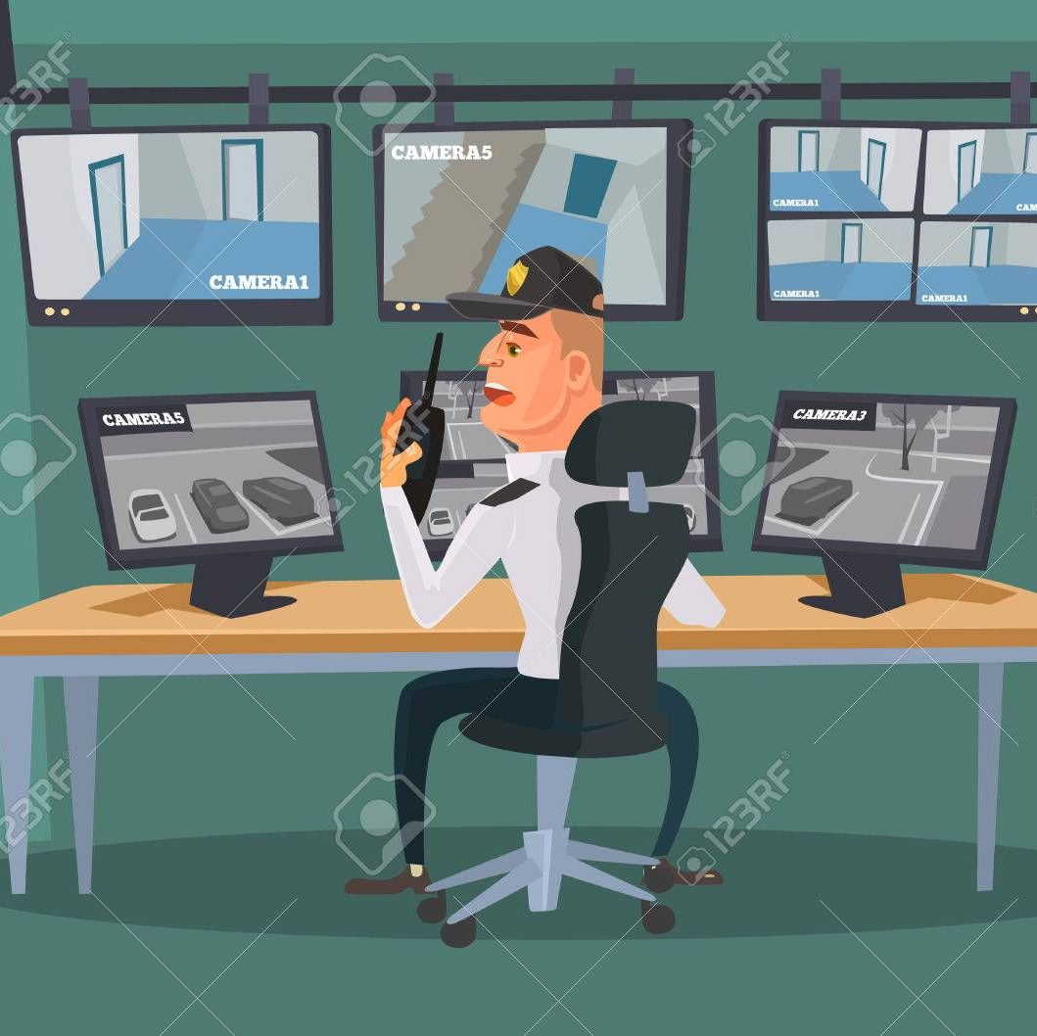
Introduction: Problem statement
Traditional Reporting.
Documentation limitation.
No prevention contribution.
Autonomous Report and fast action?

Slide 6
Related work

Slide 7
Related work: Google nest hello
Advantages:
Human Detection and Reporting (App notification).
Facial Recognition (Voice Announcement of Visitor’s Name).
Two-way Audio.
Remote Lock Control.
Disadvantages:
Not autonomous.
No Deterring module (e.g., Alarming system).

Slide 8
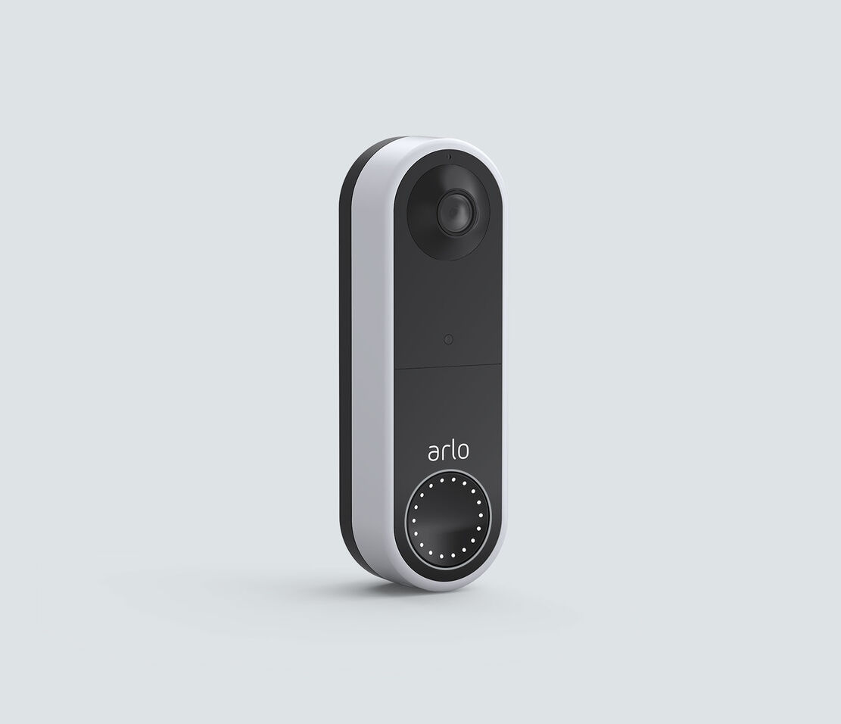
Related work: Arlo video doorbell
Advantages:
Object Detection and Reporting (Human, Vehicle, Animal).
Warning measure available (alarming system).
Two-way Audio.
Remote Lock Control.
Disadvantages:
Not autonomous.
No Facial Recognition.
Any object detected is reported to users.

Slide 9
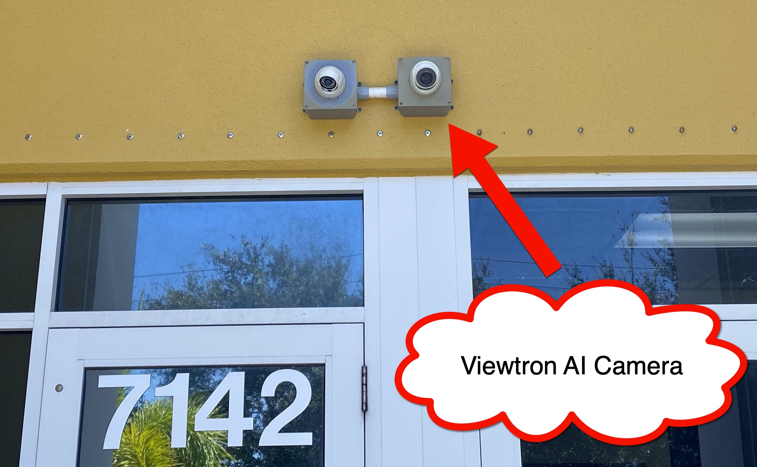
Related work: AI Face Recognition Security Camera
Advantages:
Face & Object Detection.
Facial Recognition.
Autonomous Operation.
Control via Mobile App.
Disadvantages:
No deterring measures available.
No Liveness Detection (Anti-spoofing measure).

Slide 10
Related work: Comparison
Method | Advantages | Disadvantages
Google Nest Hello | Interfaces with other google devices (voice announcement, camera…etc.). Small size. Managed by smart devices (ok google). | 298$ cost. Monthly subscription required (for extra features). No decent cloud space (for video recordings).
Arlo Doorbell System | 179$. Different modes of power (battery & wall outlet). Easy installation. Small size. All features are provided with no additional cost. Managed by smart devices (Alexa, ok google). Reliable against weather conditions. | No decent cloud space.
AI Face Recognition Security Camera | Facial recognition capability. Autonomous door unlock. Captured footage and video recordings stored locally. | Big size. Requires separate video recorder. Installation is hard. 350$-500$ cost.

Slide 11
Proposed system

Slide 12
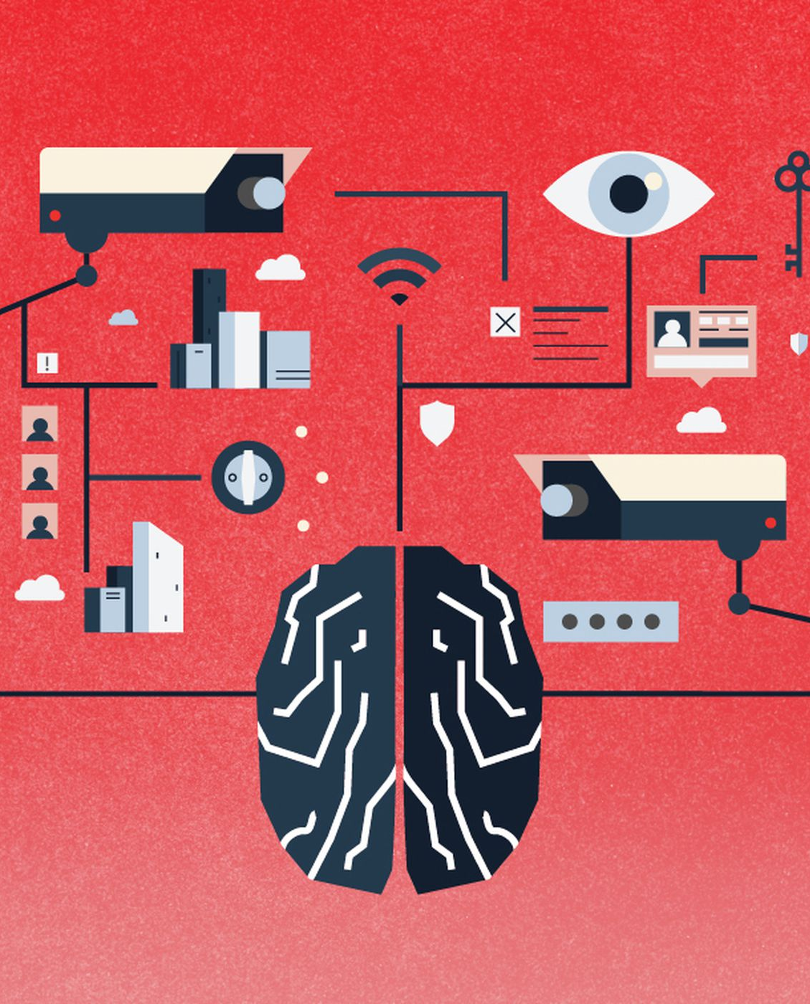
Our Solution: Make security smarter(1/2)
Use advanced technologies to improve performance by:
Face Detection Module.
Liveness Detection (Anti-spoofing).
Facial Recognition.
Real-time Reporting (App notification).
Autonomous Actions (Certain cases).
Remote Control (app control panel).
Deterrence measures (Alarming system).
Notes:
Deterrence measures are used in order to make a siren when the user senses a danger (risky visitor) in order to make him/her leave.

Slide 13
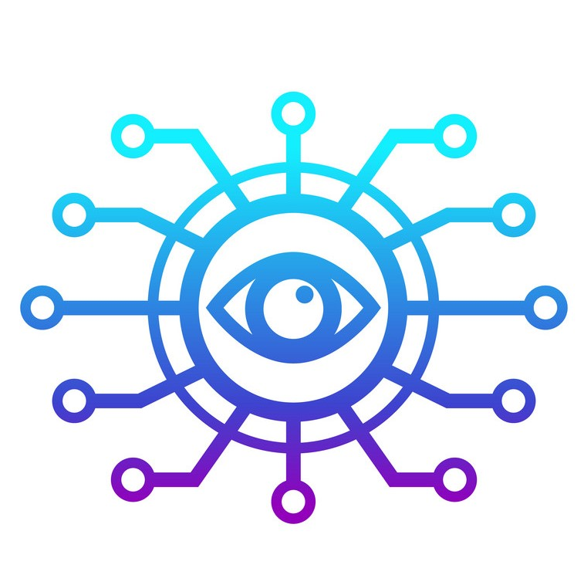
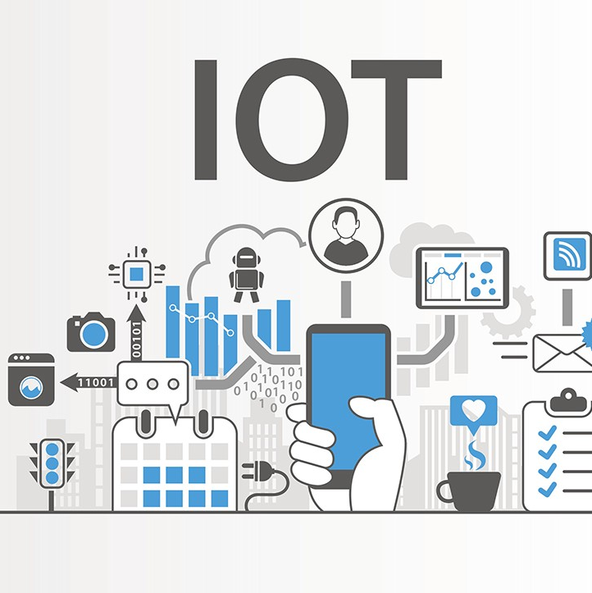
Our Solution: Make security smarter(2/2)
Approach:
Use Computer Vision and Machine Learning to:
Provide Computer with vision capabilities.
Create models for object classification (Face ROIs, Liveness, Features’ vector, ..etc.).
User Internet of Things (IoT) to:
Create a presence for the system on the internet.
Helps create a communication link with the user.
Notes:
Deterrence measures are used in order to make a siren when the user senses a danger (risky visitor) in order to make him/her leave.

Slide 14
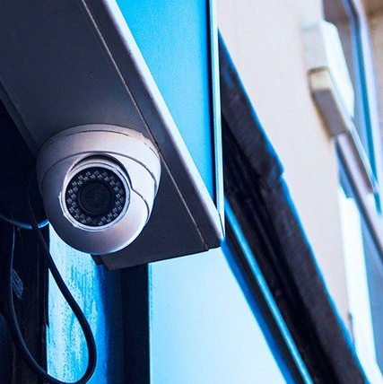
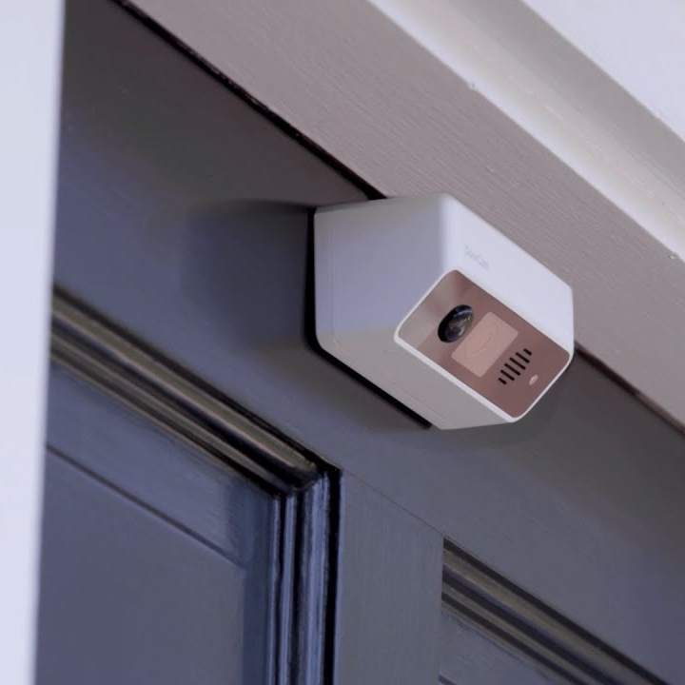
Where to use this system?
Private houses:
This system is mainly designed for house’s entrance.
Can be placed any where around the house (e.g., backyard, windows).
Offices and Companies:
Placed at main entrance to permit employees' access only.
Private spots where only certain people allowed to be in.

Slide 15
System design

Slide 16
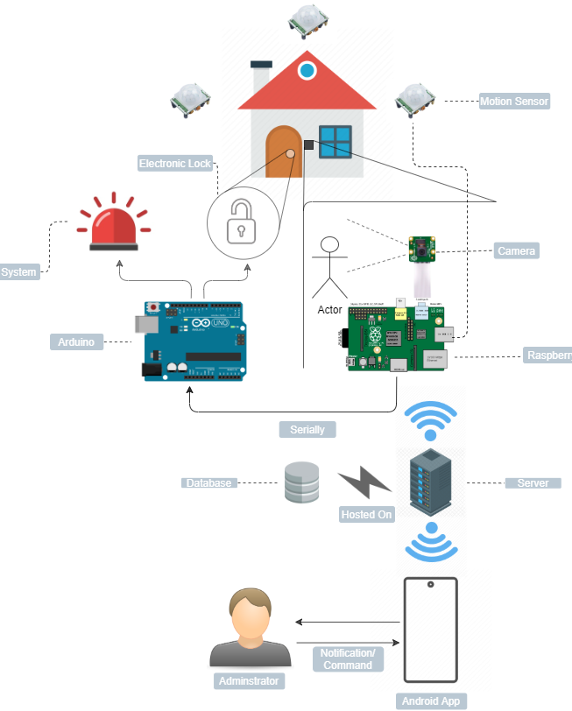
System architecture
Hardware Parts:
Raspberry Pi (Peripherals Connection link).
Arduino UNO (Slave Peripheral).
Camera Module (Visual Data).
Motion Sensors (Motion Detection).
Door Lock & Alarming System (Access vs. Block).
Notes:
Deterrence measures are used in order to make a siren when the user senses a danger (risky visitor) in order to make him/her leave.

Slide 17
System architecture
Software Parts:
Database (Laptop Local Server).
Android Application (Control & Monitoring Panel).
Notes:
Deterrence measures are used in order to make a siren when the user senses a danger (risky visitor) in order to make him/her leave.

Slide 18
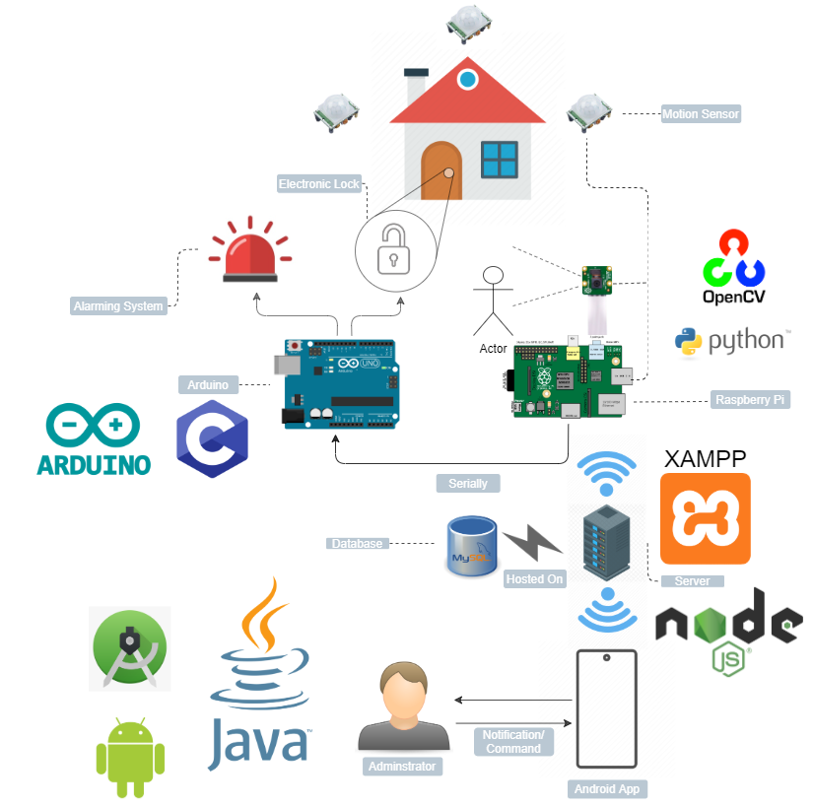
System software model
Raspberry Pi:
Python (OpenCV, TensorFlow).
Arduino UNO:
C++.
Server:
MySQL.
PHP.
Android Application:
Java.
XML.
Notes:
Deterrence measures are used in order to make a siren when the user senses a danger (risky visitor) in order to make him/her leave.

Slide 19
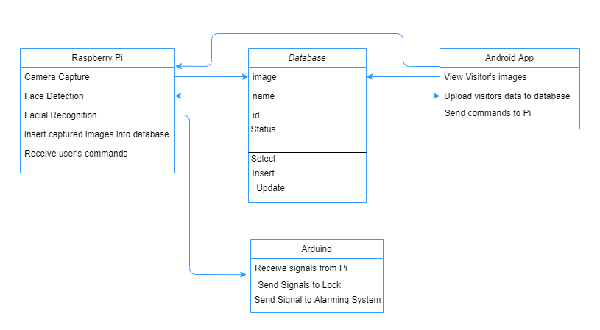
Class diagram
Database Class:
For commands and notifications.
Communication link between user and main system.
Raspberry Pi Class:
Computer Vision & IoT.
Reporting and Command Execution.
Android App Class:
Receive notifications.
Provides Control features.
Arduino Class:
Door Lock and Alarming System triggering.

Slide 20
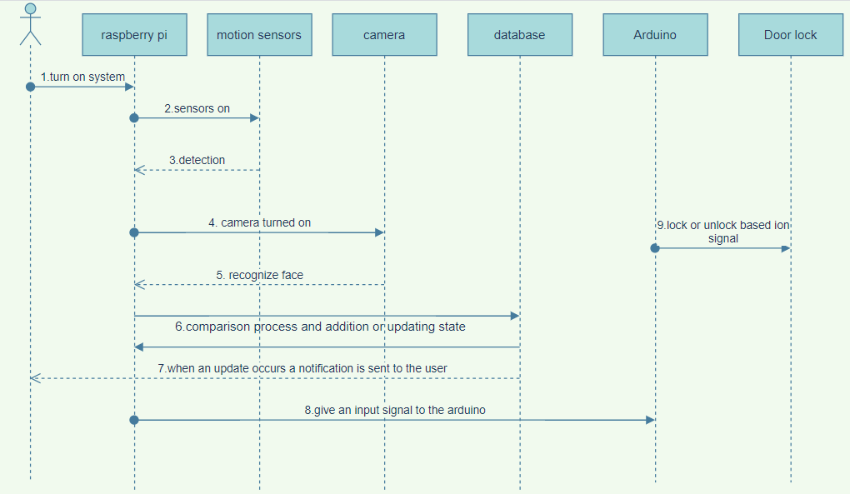
Sequence diagram
Owner will be the one to trigger the system firstly.
Automation of the system will get it to situations where the sequence might change.

Slide 21
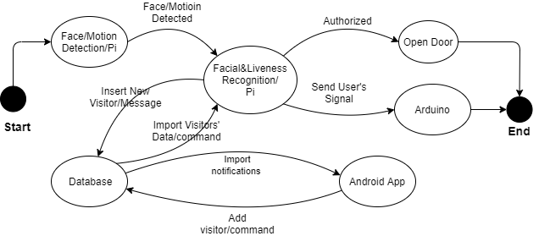
state diagram
Human Detection.
Liveness Detection & Facial Recognition.
Autonomous Action/User Notification.
User Control.
Command Handling.

Slide 22
System implementation

Slide 23
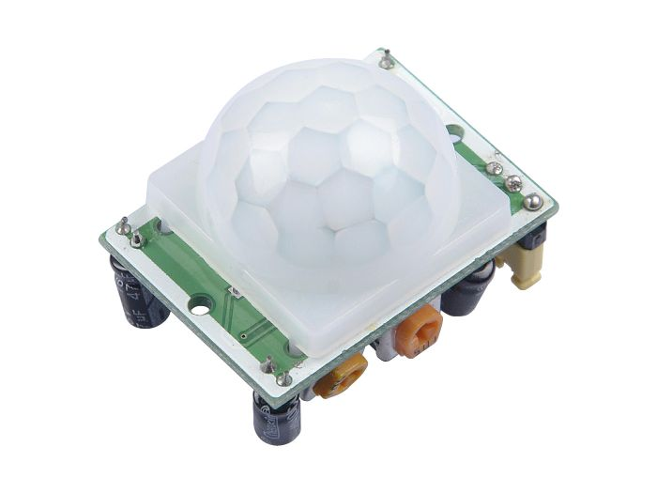
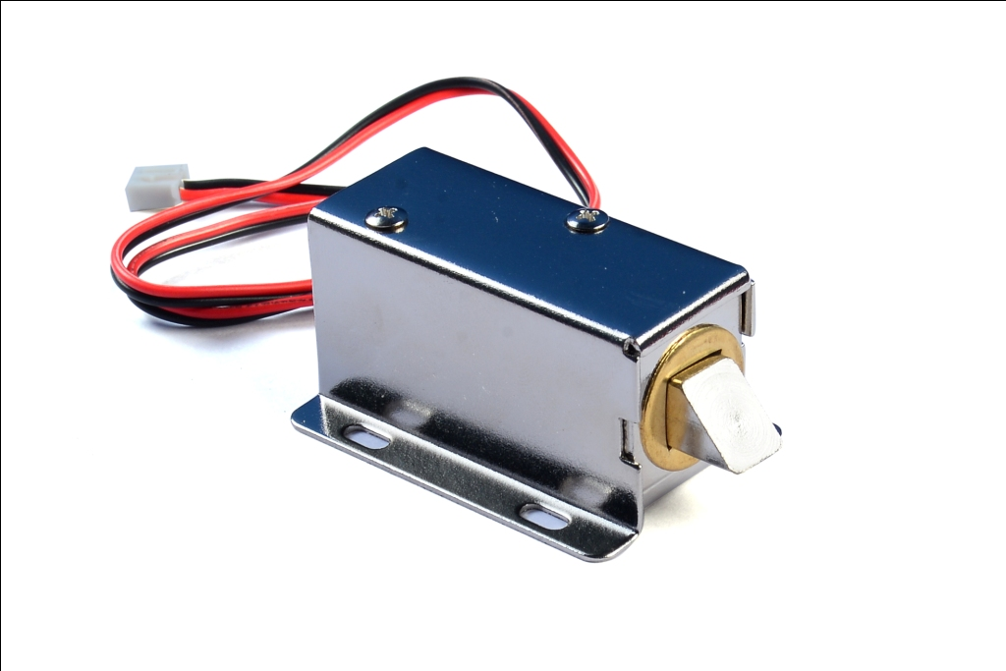
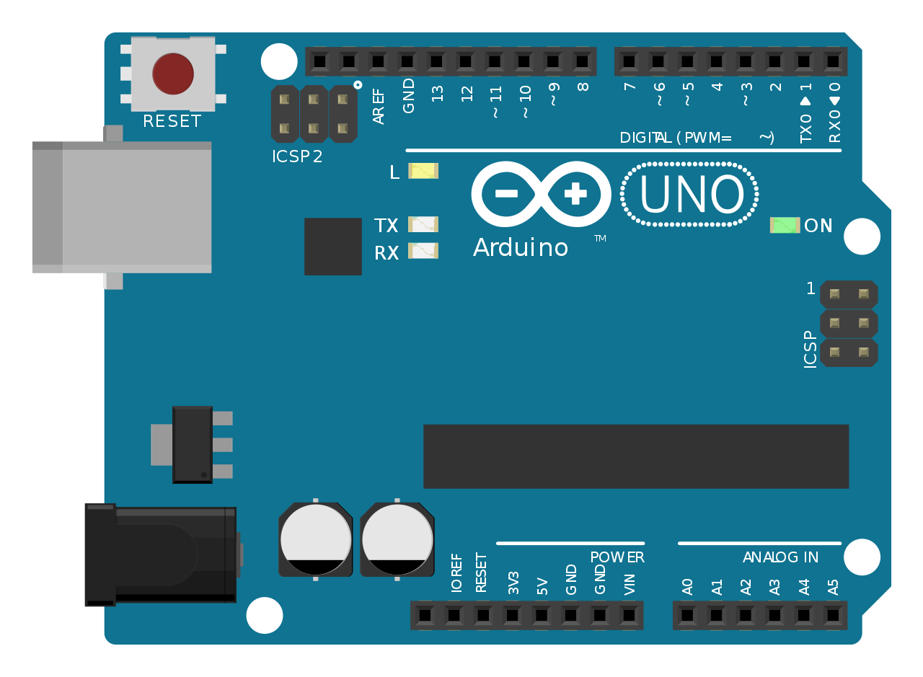
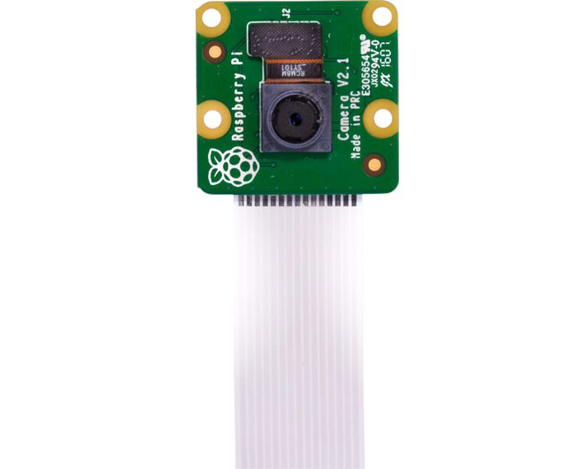
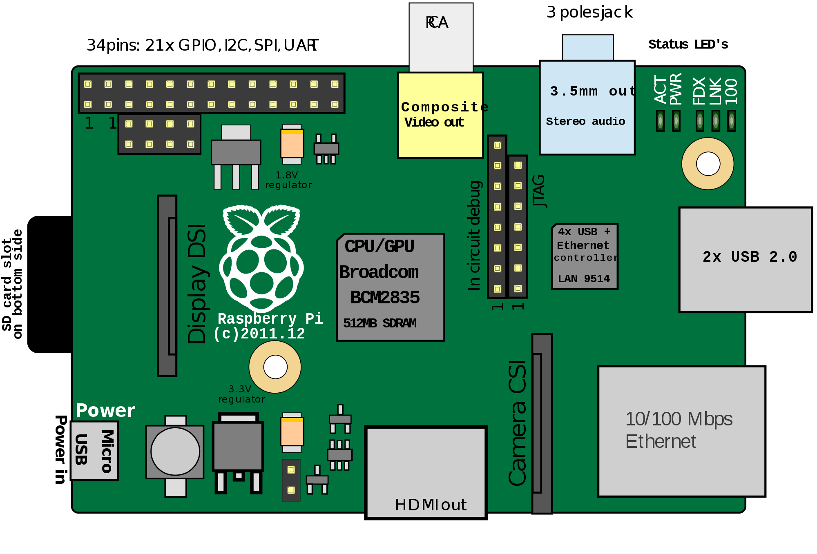
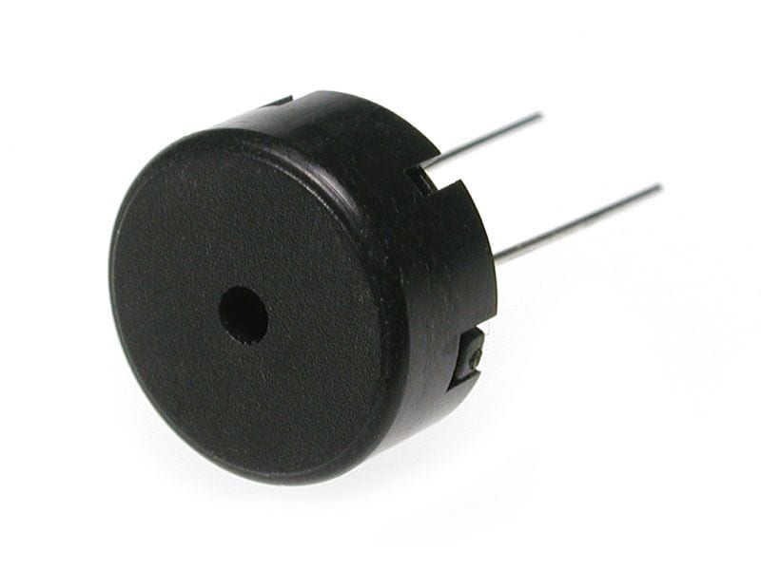
Hardware tools
PIR Motion Sensor
Arduino UNO
Electronic Lock
Raspberry Pi Camera 8MP
Raspberry PI Model B 2GB
Buzzer

Slide 24





Software tools
OpenCV Library
TensorFlow Python Library
Java
PHP (Server Side)
MySQL (Database)

Slide 25
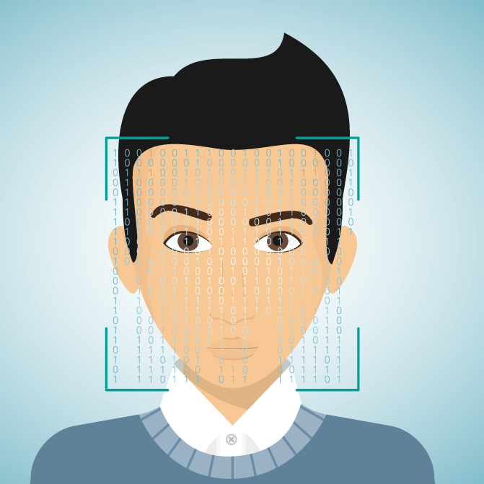
Implementation Summary (1/4): Gather Faces
Use OpenCV to collect faces from dataset videos (Fake & Real).
Save Faces ROIs to fake and real directories.
Run face detector to detect human presence.

Slide 26
Implementation Summary (2/4): Liveness Detection
Real 0.95521
Based on Machine Learning.
Classifies faces into real or fake.
Implemented to detect spoofing attempts.

Slide 27
Implementation Summary (3/4): facial Recognition
Unknown
Use Python face-recognition library (face matching).
Create and store a dataset of authorized people.
Capture an image and match it with images in prestored dataset.
If match occurs, extracts file’s name; otherwise, do nothing.

Slide 28

Implementation Summary (4/4): take action
Face is fake? Push notification => breakdown => wait command.
Face is real but unknown? Push notification.
Face is real and recognized? Open door lock.

Slide 29
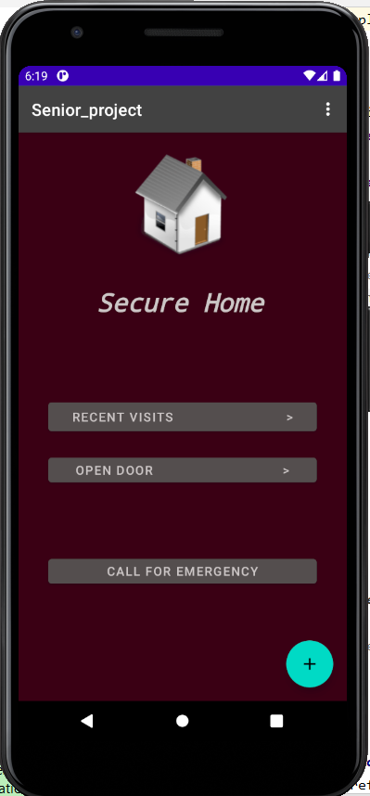

Implementation (5/7): android app
Pop-up activity where the main starts.
Each button takes the user to another activity.
While application is running in the background service will keep a track on any new visits

Slide 30
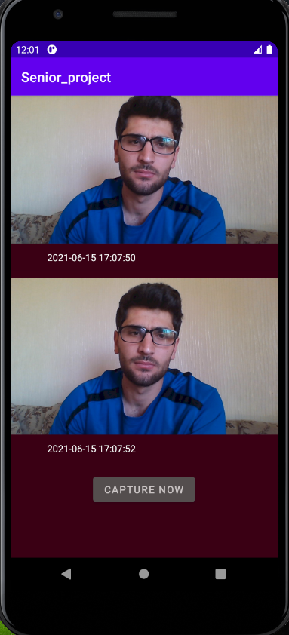
Implementation(6/7): android app
Pictures in this activity are brought from database.
Images are added to the database with an id.
The last id one is kept in the users app.

Slide 31
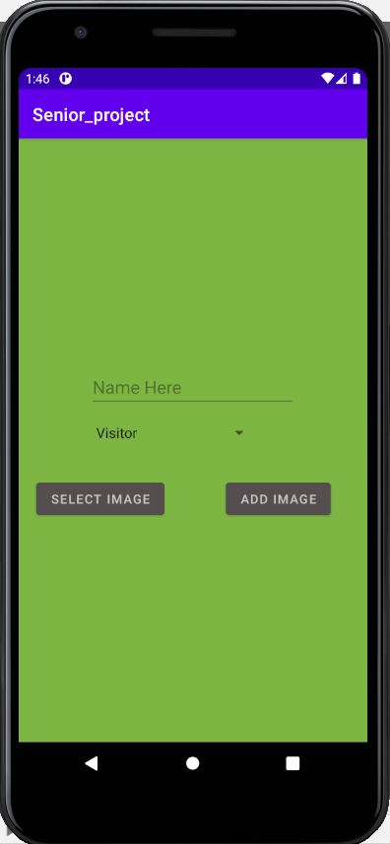
implementation(7/7): android app
Add guest activity allows the user to add specific people.
Face of added ones are token from gallery.
The user must provide a name for the person to be added.

Slide 32
Results

Slide 33
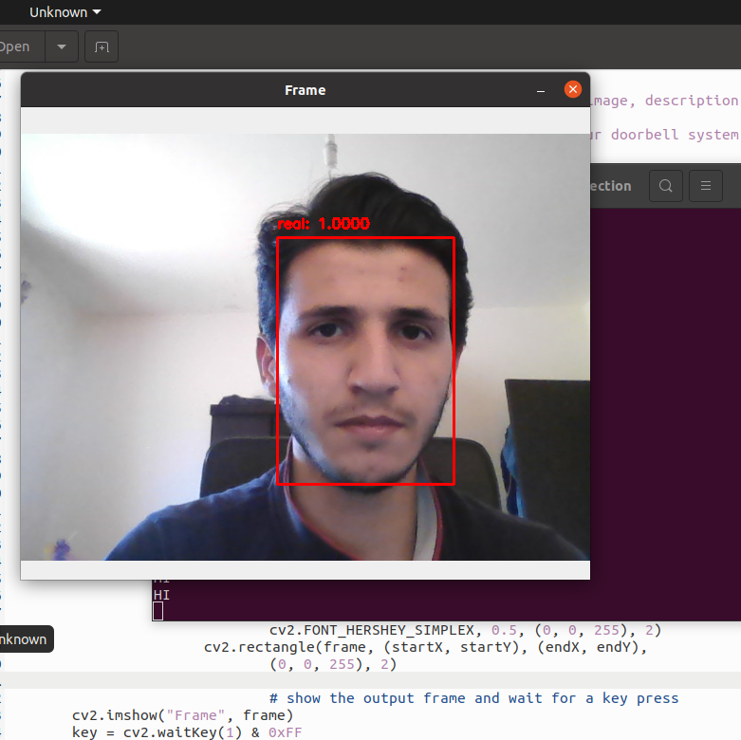
Results (1/6): liveness detection
Liveness Detection showed about 99% accuracy after detecting a real face.

Slide 34
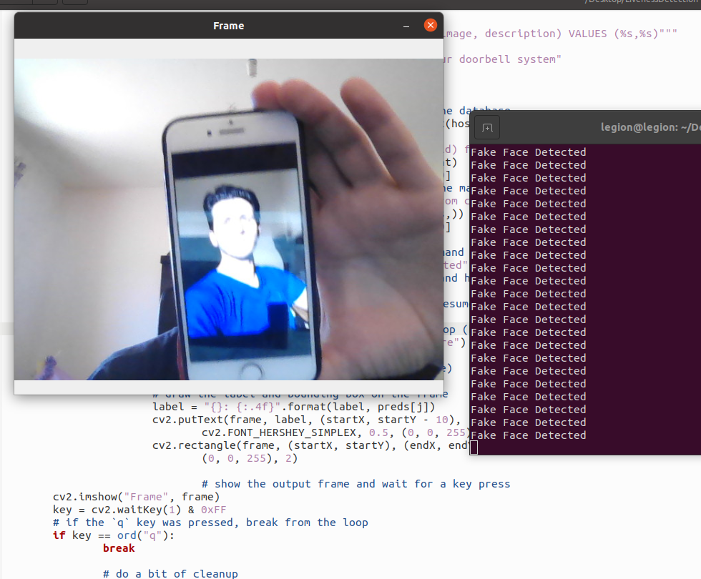
Results (2/6): liveness detection
Photo pointed at the camera.
Liveness Detector classified it as fake.

Slide 35
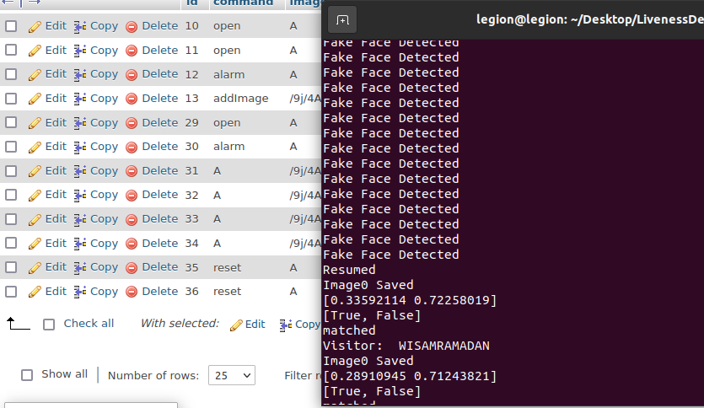
Results (3/6): System reset
Spoofing attempt notification was received.
User pressed “reset” to reset the system.

Slide 36
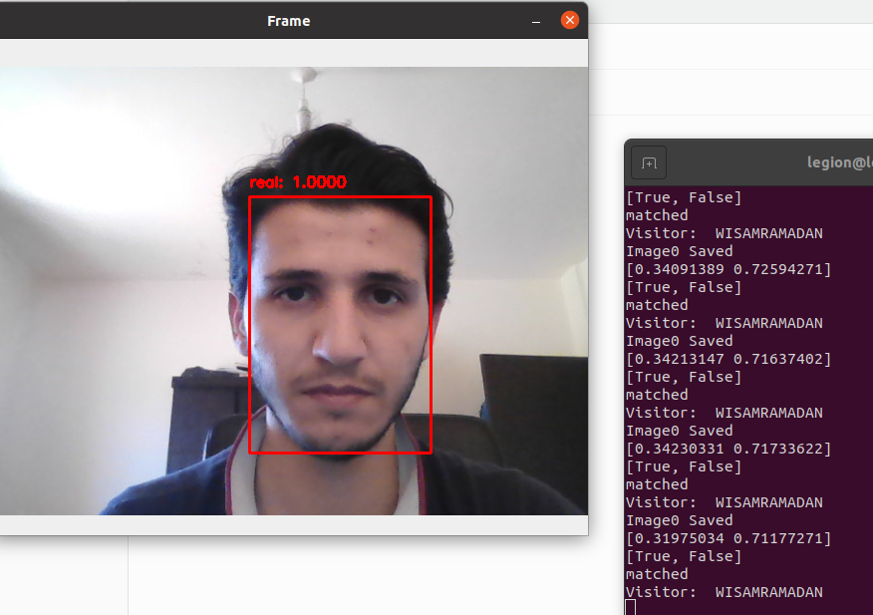
Results (4/6): facial recognition
System classified real person as real.
It found a match for the face,
Then, extracted the matched file’s name.

Slide 37
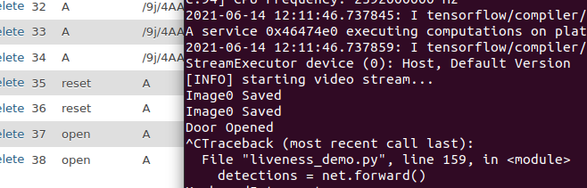
Results (5/6): Open door
User sent “Open Door” command from android app.
The system opened the door.

Slide 38
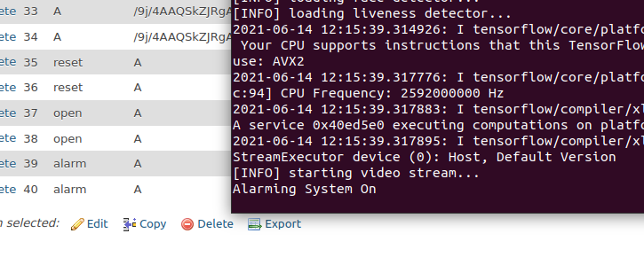
Results (6/6): alarming system turn on
User sent “Turn on alarm” command.
The system turned alarming system on.

Slide 39
Conclusion and future work

Slide 40
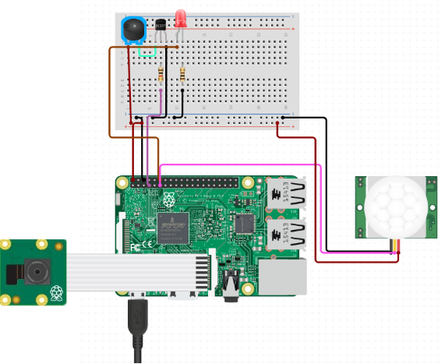
Conclusion
Machine learning provides great improvement to existing applications.
This system’s improvement is based on Computer Vision and IoT.
Compared to related works:
It operates autonomously.
It detects spoofing attempts.
However, there are still drawbacks with this proposed system.
Requires a large dataset (real & fake).
Dataset is hard to create.

Slide 41
Challenges
Not all failure conditions may be predicted.
Camera systems are affected highly by various weather conditions.
It was not feasible to test the quality of the system under different conditions.
Liveness Detection and Facial Recognition may operate with less accuracy in darkness.
This system was not tested with night vision camera.

Slide 42

Future work
The system can be improved by extending it to support:
One main administrator.
Two-way audio communication.
Video Recording.
Live Streaming.
More advanced infrared camera.
Interfaces to connect to other security systems (e.g., alarming system).
Using a more efficient computer.

Slide 43
Thank you!

